Slide 1


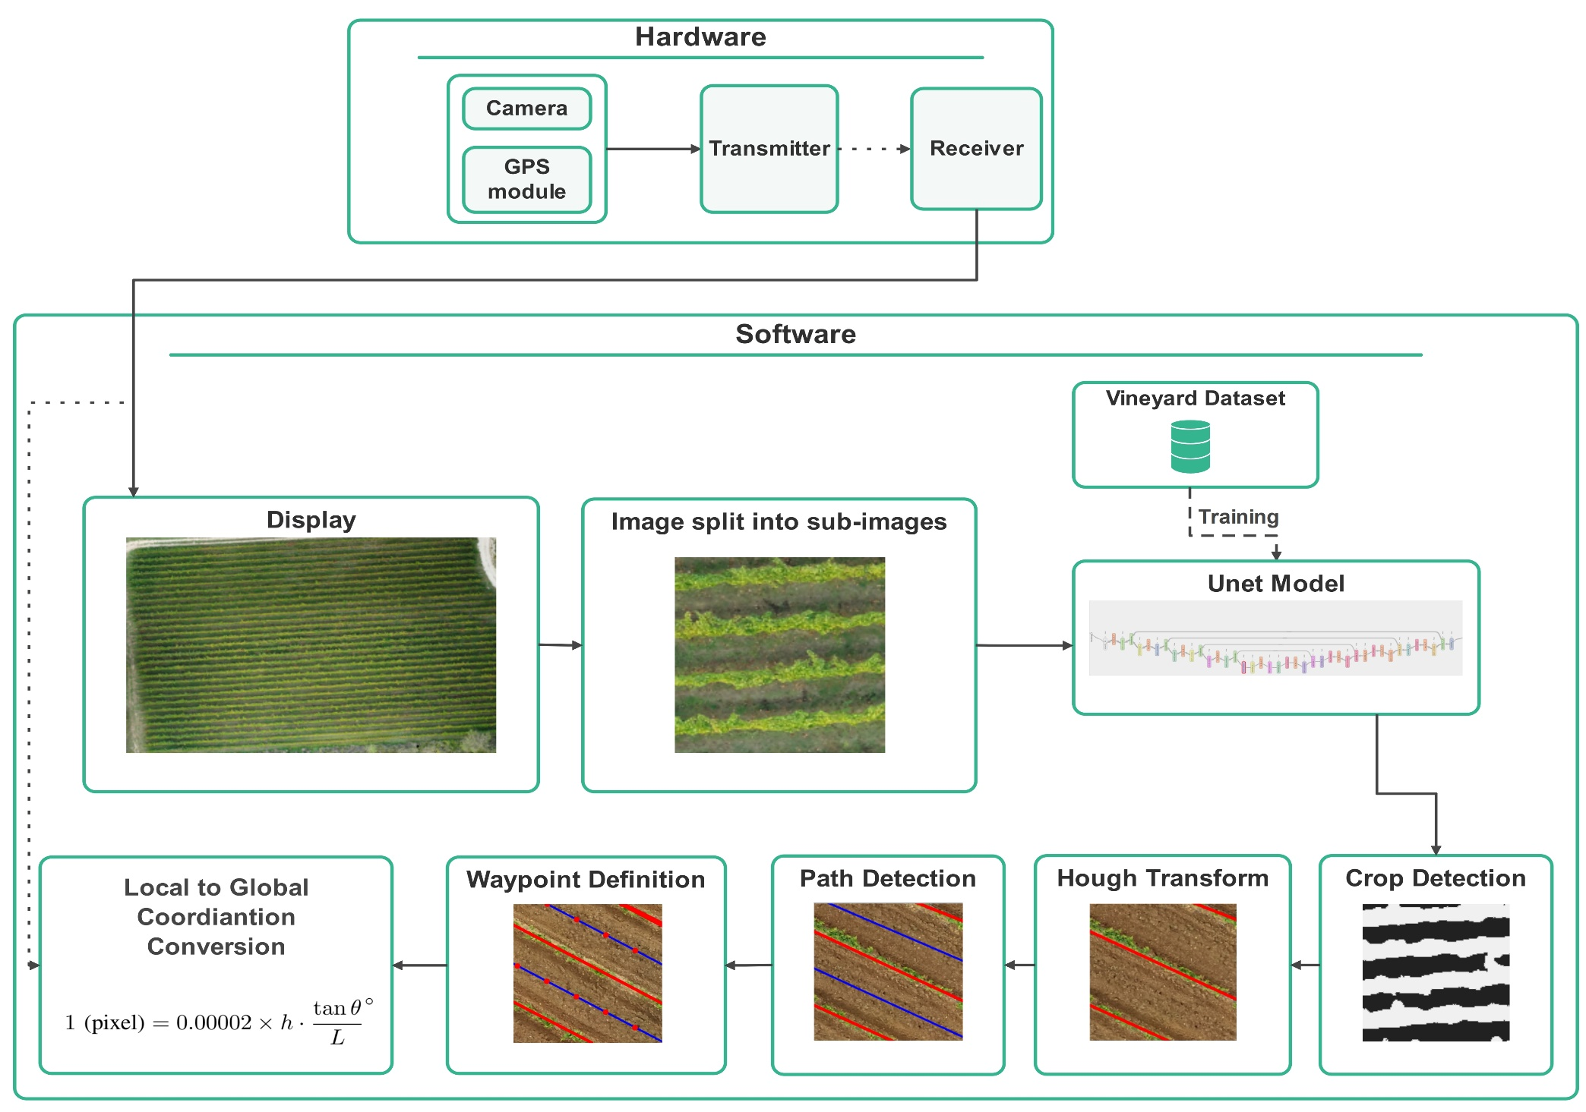
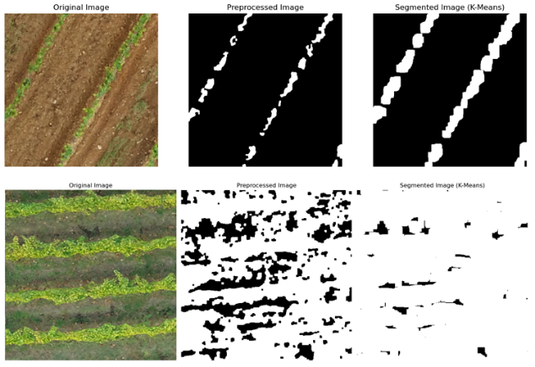
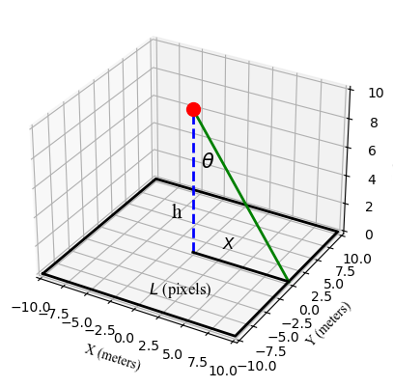
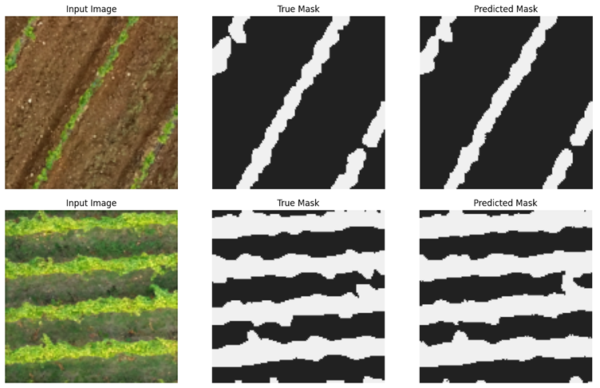
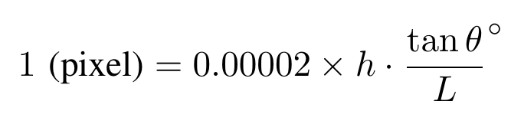
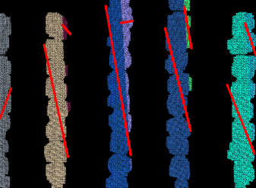
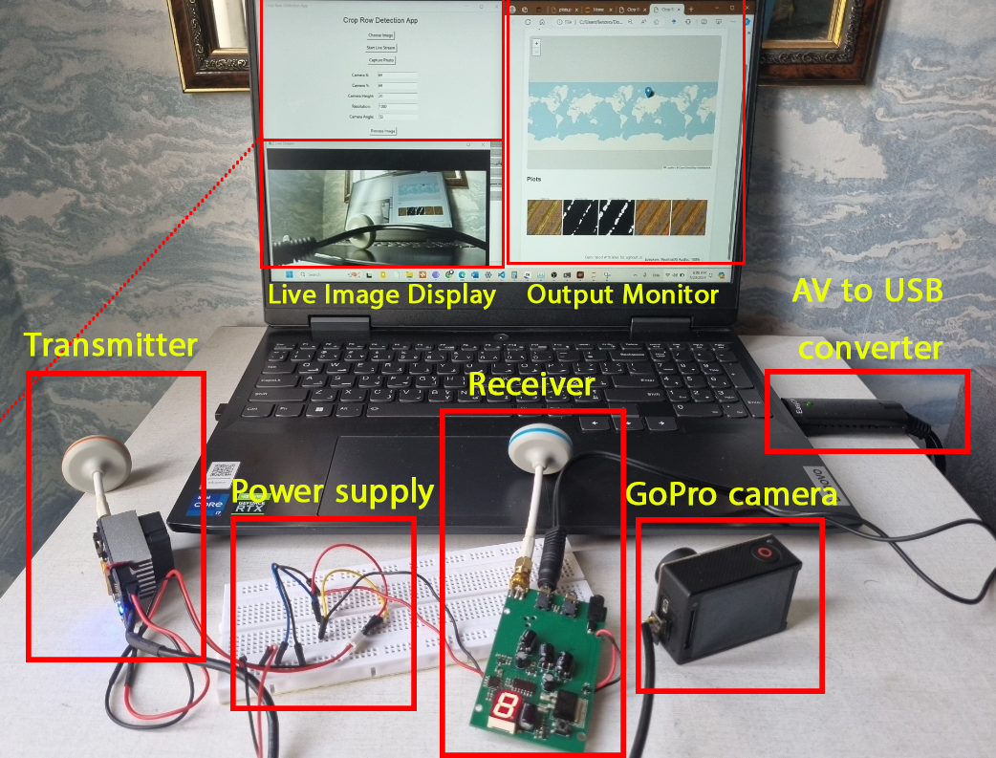
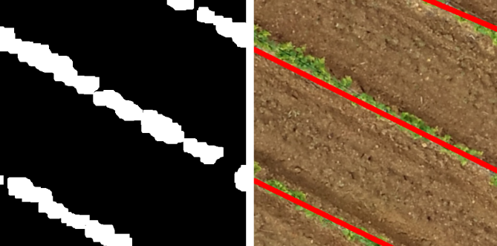
Waypoint Generation based on Crop Row Detection Using Unet and Hough Transform
The 12th RSI International Conference on
Robotics and Mechatronics (ICRoM 2024)
17-19 November 2024, Amirkabir University of Technology.
2 0 2 4
Alireza Amiri, Saeed Khankalantary
Department of Electrical Engineering, K. N. Toosi University of Technology, Tehran, Iran
Introduction
Precision Agriculture (PA) requires accurate waypoint generation to guide robots for field tasks. This paper uses a robust image processing pipeline for precise crop row detection and global coordination generation. The proposed solution involves:
Data Acquisition: Capturing aerial images of fields and transmission.
Crop Row Detection: Using deep learning (UNet) and Hough Transform for accurate crop segmentation and crop row detection.
Path Waypoint Definition: Deriving waypoints from detected crop rows.
Waypoint Generation: Converting local waypoints to global coordinates for robot navigation.
This solution enhances the accuracy and efficiency of agricultural automation navigation, contributing to smarter and more productive farming.
Fig. 1. Procedure of waypoint generation
2. Image Segmentation
Accurate crop segmentation is essential for waypoint generation. Two methods were tested:
Color-Filtering: Crops were isolated using green channel filtering but struggled with white pixels and yellow hues. Converting images to HSV format improved filtering, and K-means clustering refined results by uniting crop regions and removing noise.
UNet-Based Segmentation: A UNet model, trained on a dataset of 5089 512 by 512 sub-images extracted from aerial vineyard images, outperformed color filtering for robust and accurate segmentation of complex crop structures.
4. Waypoint Generation
Waypoints were calculated as equally spaced points along paths defined between neighboring crop rows. These local coordinates were then converted to global GPS coordinates using camera parameters and the quadcopter's GPS data, enabling accurate autonomous navigation.
Fig. 2. Color Filtering results
Fig. 6. Geometry of coordination conversion
3. Crop Row Detection
This paper aims to identify crop rows in segmented field images. Two methods were analyzed to achieve this goal:
Linear Regression: Binary crop masks and K-means clustering were used to detect and group rows. Linear regression was then applied to fit lines to these groups. However, this method was computationally expensive and sensitive to noise.
Hough Transform: was employed to detect lines in images. This approach was faster, required fewer adjustments, and proved more robust in diverse field conditions.
Fig. 3. UNet-Based results
Experimental Setup
An integrated system was developed to acquire live aerial imagery and calculate global coordinates for path waypoints. A camera and radio transmission system were used to capture and transmit real-time images. Image processing techniques, including segmentation and row detection, were implemented in a user-friendly GUI. The system can operate in both offline and online modes, enabling analysis of pre-recorded or live-streamed images.
Fig. 4. Linear regression
Fig. 7. Experimental setup of proposed system
Fig. 5. Hough Transform
Submission ID: 59 Corresponding Author’s email: ali.amiri@email.kntu.ac.ir

